Slide 1
UV@PSC
Big Memory = New Science
Jim Kasdorf
Director of Special Projects
HPC User Forum
Höchstleistungsrechenzentrum
Universität Stuttgart
July 9, 2012

Slide 2
DISCLAIMER
Nothing in this presentation represents an official view or position of any part of the U.S. government, nor of any private corporation, nor of the Pittsburgh Supercomputing Center nor of Carnegie Mellon University. All errors are my own.
I would have prepared a shorter presentation but I did not have the time (apologies to Blaise Pascal).

Slide 3
Outline
Introduction to PSC
Data Supercell*
Anton@PSC*
UV@PSC Technology
UV@PSC Science
  *For reference; perfunctory presentation

Slide 4
The Pittsburgh Supercomputing Center
Established in 1986
Joint effort of Carnegie Mellon University and the University of Pittsburgh together with the Westinghouse Electric Company
Major funding provided by U. S. NSF
Other support from NIH, DARPA, DOE, Commonwealth of Pennsylvania
Partner in NSF XSEDE - Extreme Science and Engineering Discovery & Environment (cyberinfrastructure program)

Slide 5
Pittsburgh Supercomputing Center
National Mission
Provide integrated, flexible environment for solving large-scale computational problems
Advance science and technology through collaborative and internal research
Educate researchers about benefits of supercomputing and train them in High Performance Computing (HPC)
Support local and national education efforts with innovative outreach programs
Improve competitiveness of U.S. industry through use of computational science

Slide 6
New Systems Enable New Science
X-MP
1986
Y-MP
1989
CM-2
1990
CM-5
1992
C-90
1992
XT3
2005
T3E
1996
HP SC45: TCS
2001
HP GS1280
2003
T3D
1993
SGI Altix®4700
2008
Anton
2010
SGI Altix® UV1000
2010
Notes:
XMP- air quality, YMP- EcoR1; CM2- chevron; CM5- ??, C-90 – heart model led to design of new valve; T3D gulf stream;
T3E – protein folding; TCS- mechanosenstivie proteins; Marvel-water(jordan), XT3-astrophysics (Woodward); Pople- social security numbers & privacy; Anton- leaking of water through membrane pores: Blacklight- early supermassive black holes;
Pople – SSN/privacy work

Slide 7
Current Computational Environment
Two Unique Computers
Anton: D.E. Shaw Research MD machine
    Only example outside of DESRES
Blacklight: SGI Altix® UV1000
    World’s largest ccNUMA shared memory

Slide 8
Robust Support Systems (“The Nest”)
Data Communications: LAN, MAN, WAN
  Three Rivers Optical Exchange
  Fiber-based, DWDM core infrastructure
  Over 40 Gbps of WAN connectivity
Shared Lustre Storage
Long-Term Storage (“Archiver”)
Utility systems: login nodes, etc.

Slide 9
PSC Data Supercell*
A disk-based, mass-store system
Designed to satisfy the needs of data-intensive applications:
  Safely storing very large amounts of data
  Superior read and write performance
  Enhanced functionality & flexibility
  More cost effective than tape system
Support for collaborative work
An outgrowth of
  Previous generations of PSC-wide file systems
  Initial project funding by National Archives
* ©, Patent Pending

Slide 10
Data Storage and Access
Changing demands driven by growth of data-intensive applications.
  Capacity: growth of system sizes and dataset numbers & sizes
  Performance: both higher aggregate bandwidth and lower latency
  Accessibility: local and remote access
  Heterogeneity: incorporate diverse systems
Changing technologies
  Large market for commodity disk drives → rapid development and lower cost (compared to tape)
  Powerful, open-source disk file-system software (c.f. expensive, proprietary hierarchical storage systems)

Slide 11
Goals
Performance improvements to support new, data-intensive research modes
  Lower latency (150s/tape → 15 ms/disk)
  High bandwidth at low cost (DSC is 24x DMF/tape system)
  Capacity: scalable and readily expandable
Functionality
  Expandability
  Reliability – redundancy designed in
  Data Security – superior to single tape copy
  User Interfaces – transparent to users (cf DMF/FAR)
  Support for collaborative data projects
  Manageability
Cost
  No more expensive that current tape-based systems
  Maintenance – simple self-maintenance (no costly maintenance contracts)
  Power – allow increase as long as small compared to other costs
  Space – better than old silos, no worse than best, newer robotics.

Slide 12
Building Blocks
Hardware: commodity components
  SATA disks (non-Enterprise, 3 TB, 5400 rpm)
  SuperMicro disk shelves
  SAS interconnect fabric
  Multiple, commodity servers
  10GigE interconnect fabric (→ IB when drivers available and tested)
  Redundant UPS support for all components
  Support for remote operation (including power cycling)
Software
  FreeBSD OS
  Open Source ZFS
  PSC-developed SLASH2 software
  PSC-developed monitoring, management support

Slide 13
Status / Plans
Status
  In production
  Data copied out of DMF/tape system
  Disk failure rate (including infant mortality) < vendor estimate.
Plans
  System hardening
  Adding system interfaces
  Automating operations
  Performance optimization
  Disk scrubbing (ZFS)
  Block-level deduplication (ZFS)
  Reduced power consumption (disks to standby)
  Write-read-verify
  …

Slide 14
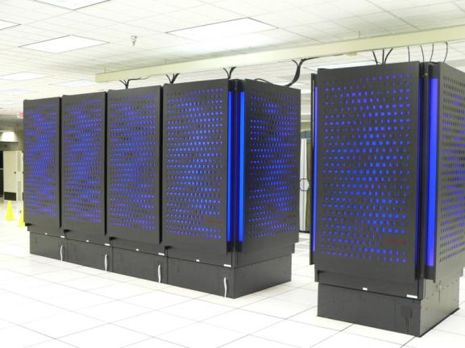
Anton

Slide 15
Anton
Massively parallel supercomputer
Designed and built by D.E. Shaw Research (DESRES)
Special-purpose system for Molecular Dynamics (MD) simulations of proteins and other biological macromolecules

Slide 16
Anton
Runs MD simulations fully in hardware
Compared to the previous state-of-the-art Anton provides a speedup of ~100 fold rendering millisecond timescales attainable
Uses custom-designed ASICs and novel simulation algorithms

Slide 17
Anton @PSC
NIH-funded National Resource for Biomedical Supercomputing at PSC
DESRES made available an Anton system without cost for non-commercial research use by not-for-profit institutions
Allocation by review committee convened by U.S. National Research Council
The Anton at NRBSC is the only one available outside of DESRES.

Slide 18
UV@PSC: Blacklight
The World’s Largest
Hardware-Coherent Shared Memory Computer
for Data Analytics and Data-Intensive Simulation

Slide 19
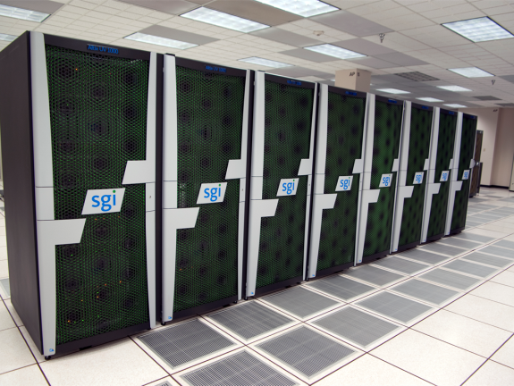
Blacklight

Slide 20
Why Shared Memory?
graph analytics
high-productivity languages
machine learning
rapid prototyping
Production use and also an experiment
data exploration
Enable
memory-intensive computation
Increase
user
productivity
algorithm expression
statistics
Change the way
we look at data
Boost scientific output
Broaden participation
interactivity
visualization
ISV
apps
...
…

Slide 21
PSC’s Blacklight: SGI Altix® UV 1000
Two×16 TB of cache-coherent shared memory
  Hardware coherency unit: 1 cache line (64B)
  16 TB exploits the processor’s full 44-bit physical address space
  Ideal for fine-grained shared memory applications, e.g. graph algorithms, sparse matrices
32 TB addressable with PGAS languages (e.g. SGI UPC)
  Low latency, high injection rate supports one-sided messaging
  Also ideal for fine-grained shared memory applications
NUMAlink® 5 interconnect
  Fat tree topology spanning full UV system; low latency, high bisection bandwidth
  Hardware acceleration for PGAS, MPI, gather/scatter, remote atomic memory operations, etc.
Intel Nehalem EX8 processors: 4096 cores (2048 cores per SSI)
  Eight-cores per socket, two hardware threads per core, four flops/clock, 2.27 GHz, 24MB L3, Turbo Boost, QPI
  Four memory channels per socket → strong memory bandwidth
  x86 instruction set with SSE 4.2 → excellent portability and ease of use
SUSE Linux operating system
  Supports OpenMP, p-threads, MPI, PGAS models → high programmer productivity
  Supports a huge number of ISV applications → high end-user productivity

Slide 22
Programming Models & Languages
UV supports an extremely broad range of programming models and languages for science, engineering, and computer science
  Parallelism
    Coherent shared memory: OpenMP, POSIX threads (“p-threads”), OpenMPI, q-threads
    Distributed shared memory: UPC, Co-Array Fortran*
    Distributed memory: MPI, Charm++
    Full Linux OS can support arbitrary domain-specific languages
  Languages
    C, C++, Java, UPC, Fortran, Co-Array Fortran*
    R, R-MPI
    Python, Perl, …
→ Rapidly express algorithms that defy distributed-memory implementation.
→ To existing codes, offer 16 TB hardware-enabled shared memory and high concurrency.
* pending F2008-compliant compilers

Slide 23
Use Cases
Interactive analysis of large datasets
  Foster totally new ways of exploring large datasets. Interactive queries and deeper analyses limited only by the community’s imagination.
  Example: Fit the whole ClueWeb09 corpus into RAM; exploring graph database technology (Neo4j) to aid in inferencing.
Familiar, high-productivity programming languages
  MATLAB, R, Java, etc.
  Leverage tools that scientists , engineers, and computer scientists already know and use. Lower the barrier to using HPC.
ISV applications
  ADINA, MolPro, MATLAB, Gaussian, VASP, ...
  Access vast memory from even a modest number of cores; extend users’ workflows from their desktop to HPC, allowing higher fidelity while applying the same validated approaches. Again, lower the barrier to using HPC.

Slide 24
Use Cases
Algorithm expression
  Rapid development of algorithms for large-scale data analysis.
  Rapid prototyping and “one-off” analyses.
  Implement algorithms and analyses, e.g. graph-theoretical, for which distributed-memory implementations have been elusive or impractical.
  Example: Hy Trac (CMU; with Renyue Cen, Princeton) began several 4.5TB, 1024-core N-body runs of 30-billion particles to study the evolution of dark matter halos during the epoch when the first stars, galaxies, and quasars formed.
    The abundance and growth of the halos will be compared with the abundance and star formation rates of early galaxies to understand the connection between mass and light in the early universe.
    He uses OpenMP (shared memory) for agile development of new algorithms and he is planning runs with 70 billion particles.

Slide 25
Big Wins: Genome Assembly
“Next Generation Sequencers”
Fast sequencing runs
Significantly decreased cost
Produce “short reads” <200bp
The Challenge: Assembling millions to billions of reads

Slide 26
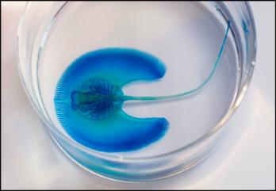
Little Skate
NIH “model organism”
Fill crucial gaps in human
biomedical knowledge
One of eleven non-mammals
No reference genome: de novo assembly
3.4 billion bases; billions of 100-base reads
ABySS s/w builds relationship graph in memory
Unsuccessful for nearly a year on distributed memory system. Draft genome in weeks on Blacklight

Slide 27

Colonial Tuco Tuco

Slide 28
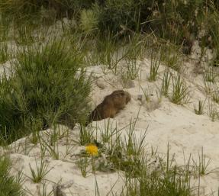
Genetic Underpinnings of Complex Phenotypes in Non-Model Mammals
Effect in transition from solitary to social living in the Colonial tuco-tuco: endangered from reduced diversity
Illumina® sequencer: billions of
bps / day: assembly requires
~700 GB. Unsuccessful on
distributed-memory system

Slide 29
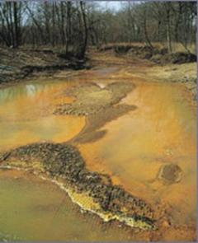
Identification of Lignocellulosic Enzymes through Sequencing and Assembly of Metagenome Soil Enrichment
Using 3.5 TB of memory, Mostafa Elshahed,
Rolf Prade, and Brian Couger (Oklahoma
State Univ.) achieved the largest metagenomic assembly to date.
  1.5 billion pair-data reads of 100 basepairs each,
  approximately 300 gigabases in total
  VelvetH / VelvetG software
Their study used a soil sample from a sugar-cane field in Brazil, enriched in a bioreactor, to identify previously unknown enyzmes that may be effective in breaking down non-feed stock lignocellulosic plants such as switchgrass and wheat straw. Such enzymes could produce biofuel with a much higher ratio of energy per quantity of input crop.
Metagenomics allows the study of microbial communities like those present in this stream receiving acid drainage from surface coal mining.
Notes:
Analysis of the assembled metagenome is still
underway, and indicates more than 8,000 gene
candidates related to glycoside hydrolase, a
category of enzymes that can degrade plant cell walls.

Slide 30
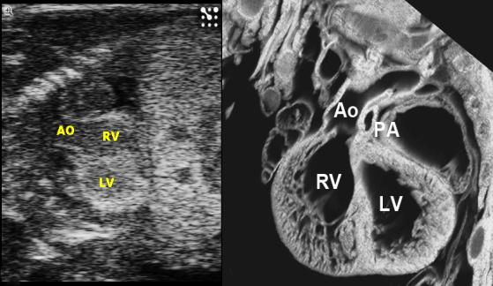
Genetic Basis for Congenital Heart Disease
Screening >100,000 mouse fetuses for heart defects
Sequence defective mouse genome and compare to healthy mouse
Life Technologies SOLiD™ sequencer: 700M reads
CLC Bio sw on Blacklight: whole-mouse assembly: 8hr

Slide 31
Many More Assemblies
Cold Spring Harbor Laboratory
  Four wheat species : ALLPATHS-LG
  Triticum aestivum: 16 Gbp; 5TB RAM; largest assembly ever
De novo transcriptome assemblies
  USDA, Forest Service: Douglas fir
  University of Virginia:Trinity / ALLPATHS-LG
  University of Miami: Functional and comparative genomics

Slide 32
Big Wins: Chemistry and Materials Science
Re-parameterize MD force fields for RNA
  MP2/aug-cc-pvtz calculations on mononucleotides with ~30 atoms
  “Same calculations on Kraken take an order of magnitude longer and they irritate the sysadmins because they swamp the disk resources.
Molpro Hartree-Fock and closed-shell CCSD(t) simulations to calculate the energy of a trimer
  Uses a large amount of memory from the large basis set used

Slide 33
Big Wins: Visualization
MassiveBlack: Largest Cosmological Simulation of Its Kind – Black Hole and Galaxy Formation
Kraken Simulation: 100K cores, 65.5 billion particles
Moved four TB to Blacklight: hold complete snapshot in memory to color-map properties interactively

Slide 34
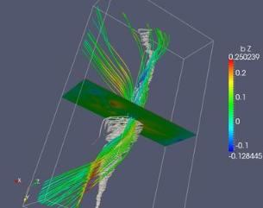
Role of Electron Physics in Development of Turbulent Magnetic Reconnection in Collisionless Plasmas
Homa Karimabadi (University of California,
San Diego) et al. have characterized, with
much greater realism than was previously
possible, how turbulence within sheets of
electrons generates helical magnetic structures
called “flux ropes” — which physicists believe
play a large role in magnetic reconnection.
Used Blacklight (working with PSC
scientist Joel Welling) to visualize the
simulations, one run of which can generate
over 200 terabytes.
Blacklight’s shared-memory architecture was
critical, says Karimabadi, for the researchers
being able to solve the physics of flux rope formation.
Their findings are important for NASA’s upcoming Magnetosphere Multiscale Mission to observe and measure magnetic reconnection.
This visualization, produced on Blacklight, shows magnetic-field lines (intensity coded by color, blue through red, negative to positive) and associated tornado-like streamlines (white) of a large flux rope formed due to tearing instability in thin electron layers.

Slide 35
Many New Areas
Economics
Natural Language Processing
Mining Large Graphs
Malware Triage and SW Security
Machine Learning
Behavioral and Neural Sciences
  Understanding Neural Pathways
Computer and Computation Research

Slide 36
Summary
Blacklight’s hardware-enabled cache-coherent shared memory is enabling new data-intensive and memory-intensive analytics and simulations. In particular, Blacklight is:
  Enabling new kinds of analyses on large data
  Bringing new communities into HPC
  Increasing the productivity of both “traditional HPC” and new users
PSC is actively working with the research community to bring these powerful analysis capabilities to diverse fields of research.
Demand for Blacklight is very high: 22M hours requested at the June XRAC meeting for only 7M hours available.
As an experiment in architecture, Blacklight is a clear success.

Slide 37
Acknowledgements
Markus Dittrich, NSBRC Group Leader
Michael Levine, Scientific Director
Nick Nystrom, Director of Strategic Applications
J. R. Scott, Director of Systems and Operations

